Slide 1
Computational Physics (Lecture 20)
PHY4061

Slide 2
Principles of Parallel computers and some Impacts on their programming models
Key technology developed in the last 25 years in solving scientific, mathematical and technical problems.
A broad spectrum of parallel architectures has been developed.

Slide 3
A parallel algorithm can be efficiently implemented
Only if it is designed for the specific needs
Basic introduction to the architectures of parallel computers.

Slide 4
Overview of architecture principles
The first super computer architectures
The use of one or a few of the fastest processors
By increasing the packing density, minimizing switching time, heavily pipelining the system and employing vector processing techniques.

Slide 5
Vector processing:
Highly effective for certain numerically intensive applications.
Much less effective in commercial uses like online transaction processing or databases.
Computational speed was achieved
At substantial costs: highly specialized architectural hardware design and renunciation of such techniques as virtual memory.

Slide 6
Another way is to use multiprocessor systems (MPS).
Only small changes to earlier uniprocessor systems.
By adding a number of processor elements of the same type to multiply the performance of a single processor machine.
The essential fact of a unified global memory could be maintained.

Slide 7
Later, the unified global memory is not required.
The total memory is distributed over the total number of processors
Each one has a fraction in the form of a local memory.

Slide 8
Massively parallel processors appeared in 80’s.
Using low cost standard processors to achieve far greater computational power.
One problem:
For the use of such systems
Development of appropriate programming models.

Slide 9
No standard models.
A few competing models
Message passing, data-parallel programming, virtual shared memory concept.
Efficient use of parallel computers with distributed memory requires:
Exploitation of data locality.

Slide 10
If the performance needs increase:
A cluster of interconnected workstations can be considered as a parallel machine.
The interconnection network of such clusters is characterized by relatively small bandwidths and high latency.

Slide 11
We can realize integrate massively parallel processors, multiprocessor systems, cluster of interconnected workstations, vector computers into a network environment and combine them to form a heterogeneous super computer.
Message-passing interface (MPI) is a landmark achievement in making such systems programmable.

Slide 12
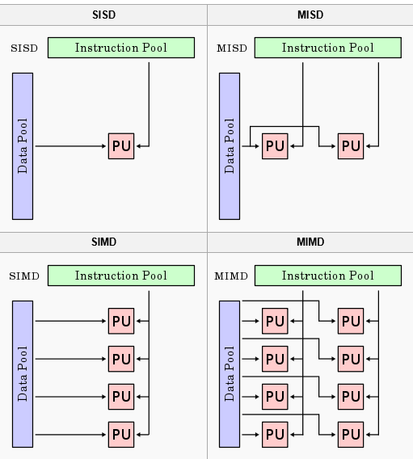
Flynn’s classification of computer architectures

Slide 13
Message passing multicomputers:
The processors in a multiprocessor system communicate with each other through shared variables in a common memory, each node in a multicomputer system has a local memory, not shared with other nodes.
Interprocessor communication is done through message passing.

Slide 14
Massively parallel processor systems
Hundreds or several thousands of identical processors, each has its own memory.
Distributed memory multicomputers are most useful for problems that can be broken into many relatively independent parts.
The interaction should be small
Interprocessor communication can degrade the system performance.
Limiting factors: bandwidth and latency.

Slide 15
Message passing programming model
The communication channels are mapped onto the communication network.
The communication hardware is capable of operating independently of its assigned compute node so that communication and computation can be done concurrently.

Slide 16
The efficiency is determined by the quality of mapping the process graph with its communication edges onto the distributed memory architecture.
In the ideal case,
Each task gets its own processor, every communication channel corresponds with a direct physical link between both communication nodes.

Slide 17
Available processors in massively parallel systems.
Scalability requires a relatively simple communication network.
Compromises are unavoidable.
For example: a logical communication channel is routed when it passes one or more grid points. The transfer of data takes time. If there is no hardware support, routing must be done by software emulation.

Slide 18
On one hand, communication paths with different delays arise by non-optimal mapping of communication channels onto the network.
On the other hand, several logical channels are multiplexed on one physical link.
Therefore, usable communication bandwidth is decreased.

Slide 19
In recent years, adaptive parallel algorithms are developed.
The decision of how to imbed the actual process graph into the processor graph can’t be made statically at the compile time, but only at the runtime.
Newly created tasks should be placed on processors with less workload to ensure a load balance.
The communication paths should be kept as short as possible and not be overloaded by existing channels.

Slide 20
Programming Using MPI
Message passing is a widely-used paradigm for writing parallel applications.
For different hardware platforms, the implementations are different!
To solve this problem, one way is to propose a standard.
The required process started in 1992 in a workshop.
Most of the major vendors, researchers involved.
Message passing interface standard, MPI.
https://www.mcs.anl.gov/mpi-symposium/slides/david_w_walker_25yrsmpi.pdf

Slide 21
The main goal stated by MPI forum is:
“to develop a widely used standard for writing message passing programs. As such the interface should establish a practical, portable, efficient, and flexible standard for message passing”.
Other goals are:
To allow efficient communication (memory to memory copying, overlap of computation and communication).
To allow for implementations that can be used in heterogenous environments,
To design an interface that is not too different from current practice, such as PVM, Express.

Slide 22
The MPI standard is suitable for developing programs for distributed memory machines, shared memory machines, networks of workstations, and a combinations of these.
Because the MPI forum only defines the interfaces and the contents of message passing routines, everyone may develop his own implementation.
MPICH will be introduced here
Developed by Argonne National Laboratory/Mississippi State University.

Slide 23
The basic structure of MPICH
Each MPI application can be seen as a collection of concurrent processes. In order to use MPI functions, the application code is linked with a static library provide by the MPI software package.
The library consists of two layers. The upper layer comprises all MPI functions that have been written hardware independent.
The lower layer is the native communication subsystem on parallel machines or another message passing system, like PVM or P4.

Slide 24
P4 offers less functionality than MPI, but supports a wide variety of parallel computer systems.
The MPI layer accesses the P4 layer through an abstract device interface.
So all hardware dependencies will be kept out of the MPI layer and the user code.

Slide 25
Processes with identical codes running on the same machine are called clusters in P4 terminology.
P4 clusters are not visible to an MPI application.
In order to achieve peak performance, P4 uses shared memory for all processes in the same cluster.
Special message passing interfaces are used for processes connected by such an interface.
All processes have access to the socket interface.
Standard for all UNIX machines.

Slide 26
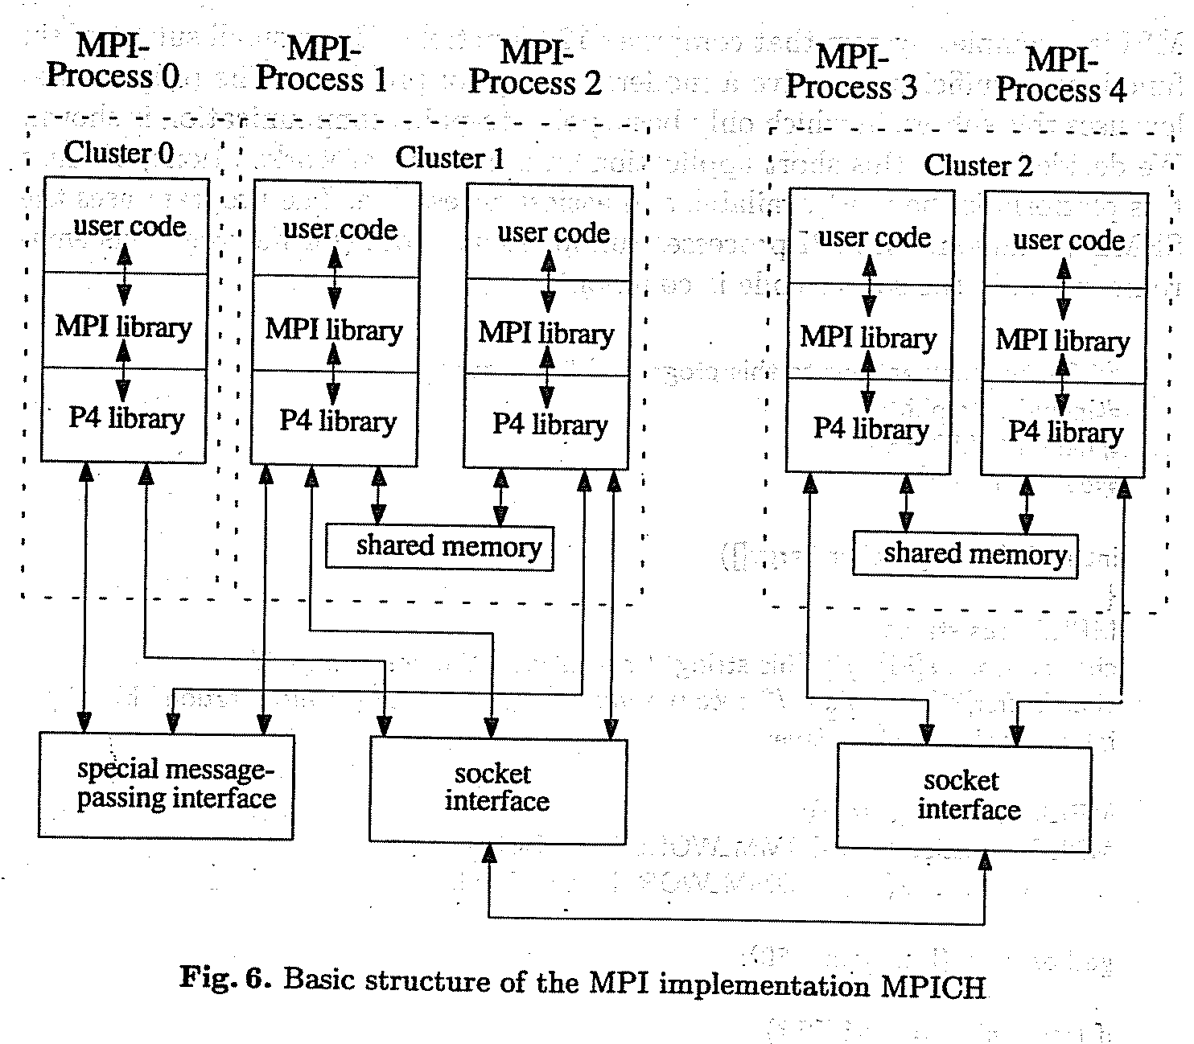

Slide 27
What is included in MPI?
Point to point communication
Collective operations
Process groups
Communication contexts
Process topologies
Bindings for Fortran77 and C
Environmental Management and inquiry
Profiling interface.

Slide 28
What does the standard exclude?
Explicit shared memory operations
Support for task management
Parallel I/O functions

Slide 29
MPI says “hello world”
MPI is a complex system that comprises 129 functions.
But a small subset of six functions is sufficient to solve a moderate range of problems!
The hello world program uses this subset.
Only a basic point-to-point communication is shown.
The program uses the SPMD paradigm.
Similar to SIMD
All MPI processes run identical codes.

Slide 30
The details of compiling this program depend on the systems you have.
MPI does not include a standard for how to start the MPI processes.
Under MPICH, the best way to describe ones own parallel virtual machine is given by using a configuration file, called a process group file.
On a heterogeneous network, which requires different executables, it is the only possible way. The process group file contains the machines (first entry), the number of processes to start (second entry) and the full path of the executable programs.

Slide 31
Example process group file hello.pg
Sun_a 0 /home/jennifer/sun4/hello
Sun_b 1 /home/jennifer/sun4/hello
Ksr1 3 /home/jennifer/ksr/ksrhello
Suppose we call the application hello, the process group file should be named hello.pg.
To run the whole application it suffices to call hello on workstation sun_a, which serves as a console.
A start-up procedure interprets the process group file and starts the specified processes.
sun-_a > hello

Slide 32
The file above specifies five processes, one on both Sun workstations and three on a KSR1 virtual shared memory multiprocessor machine.
By calling hello on the console (in this case, sun_a), one process group file contains as number of (additional) processes the entry zero to start on every workstation just one process.

Slide 33
This program demonstrates the most common method for writing MIMD programs. Different processes, running on different processors, can execute different program parts by branching within the program based on an identifier. In MPI, this identifier is called rank.

